Slide 1
COVID19 CASES IN INDIA PROJECT
File created on: 25-07-2023 15:16:19

Slide 2
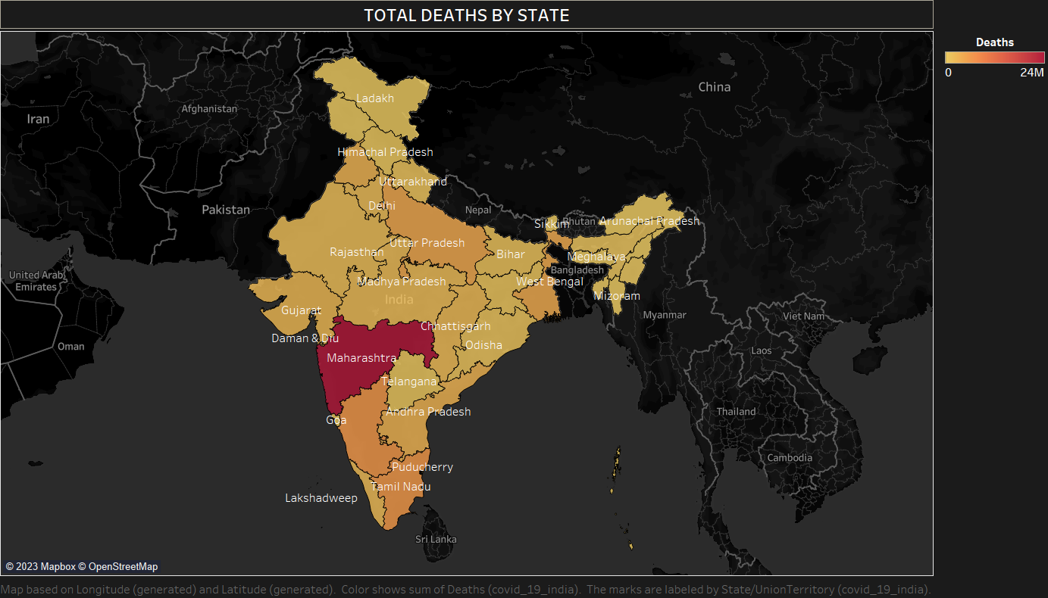

Slide 3
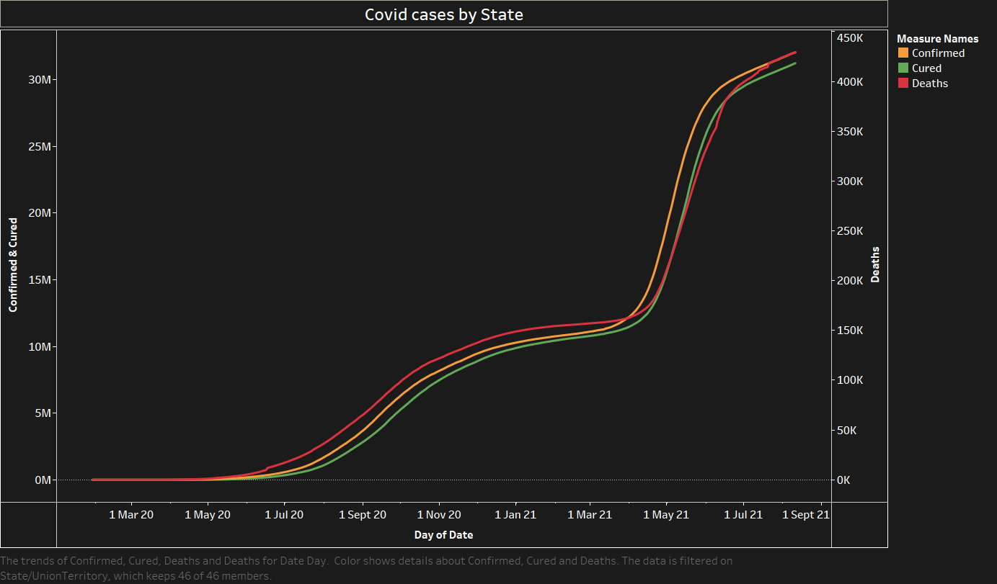

Slide 4


Slide 5


Slide 6
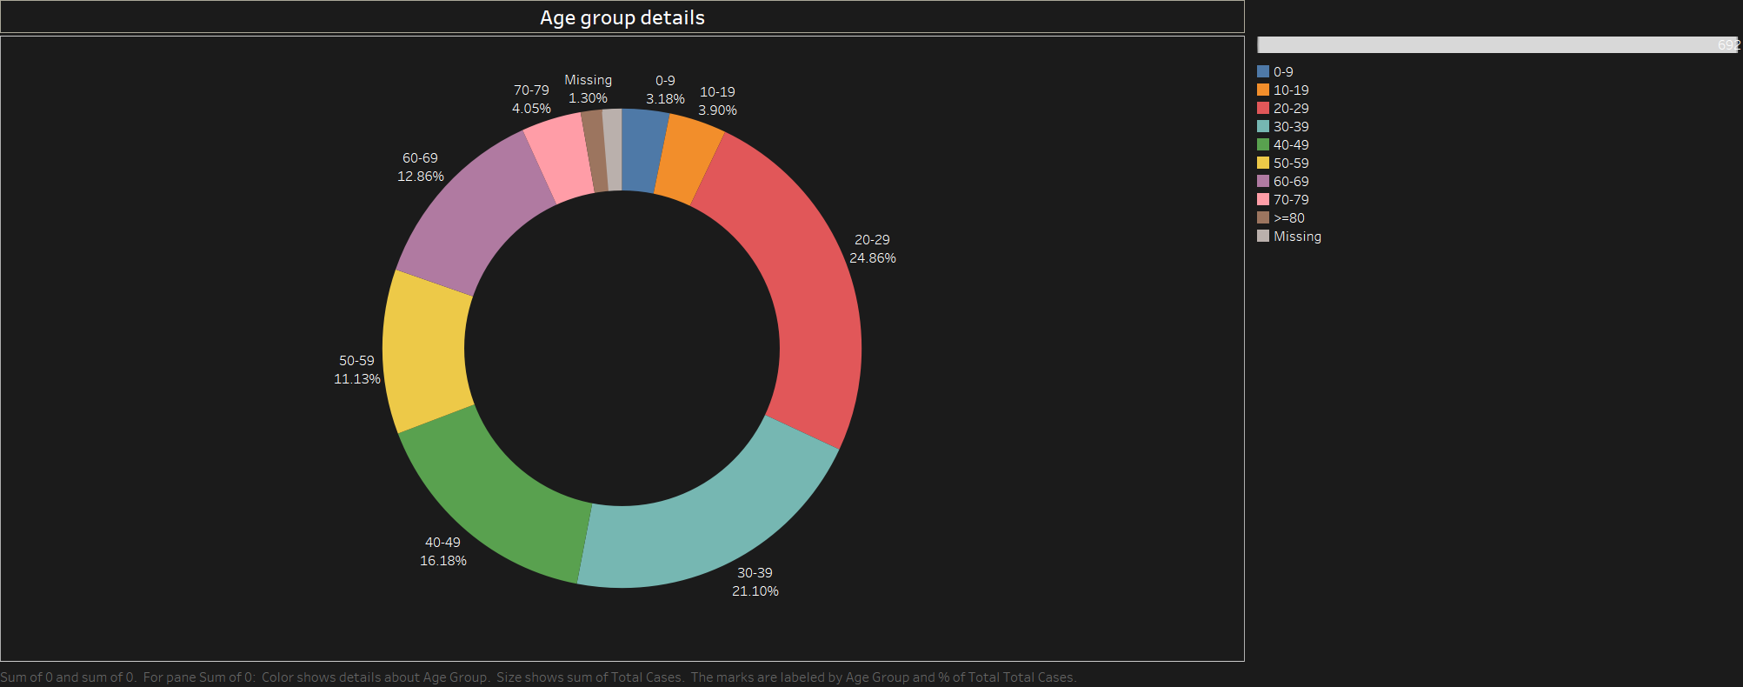

Slide 7
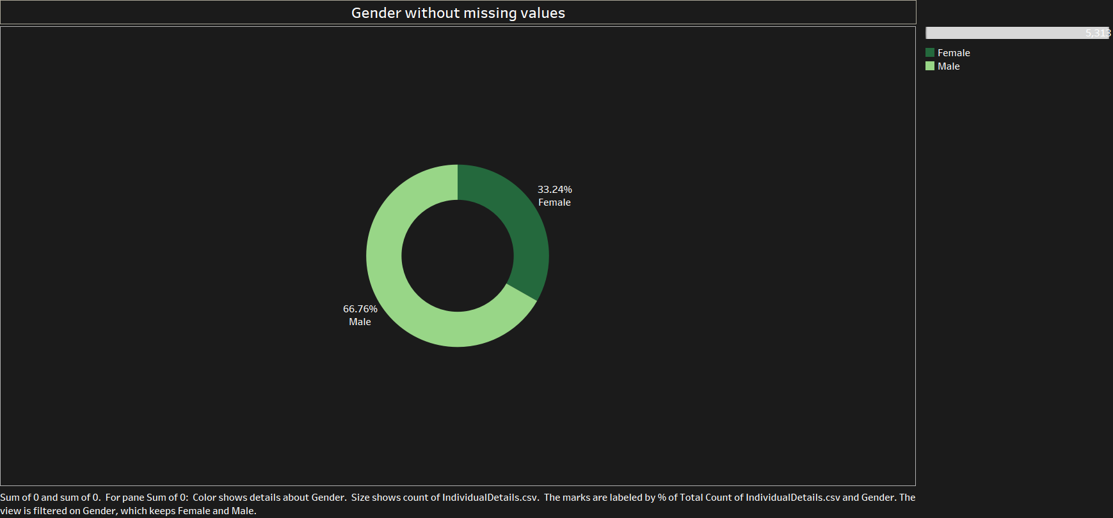

Slide 8
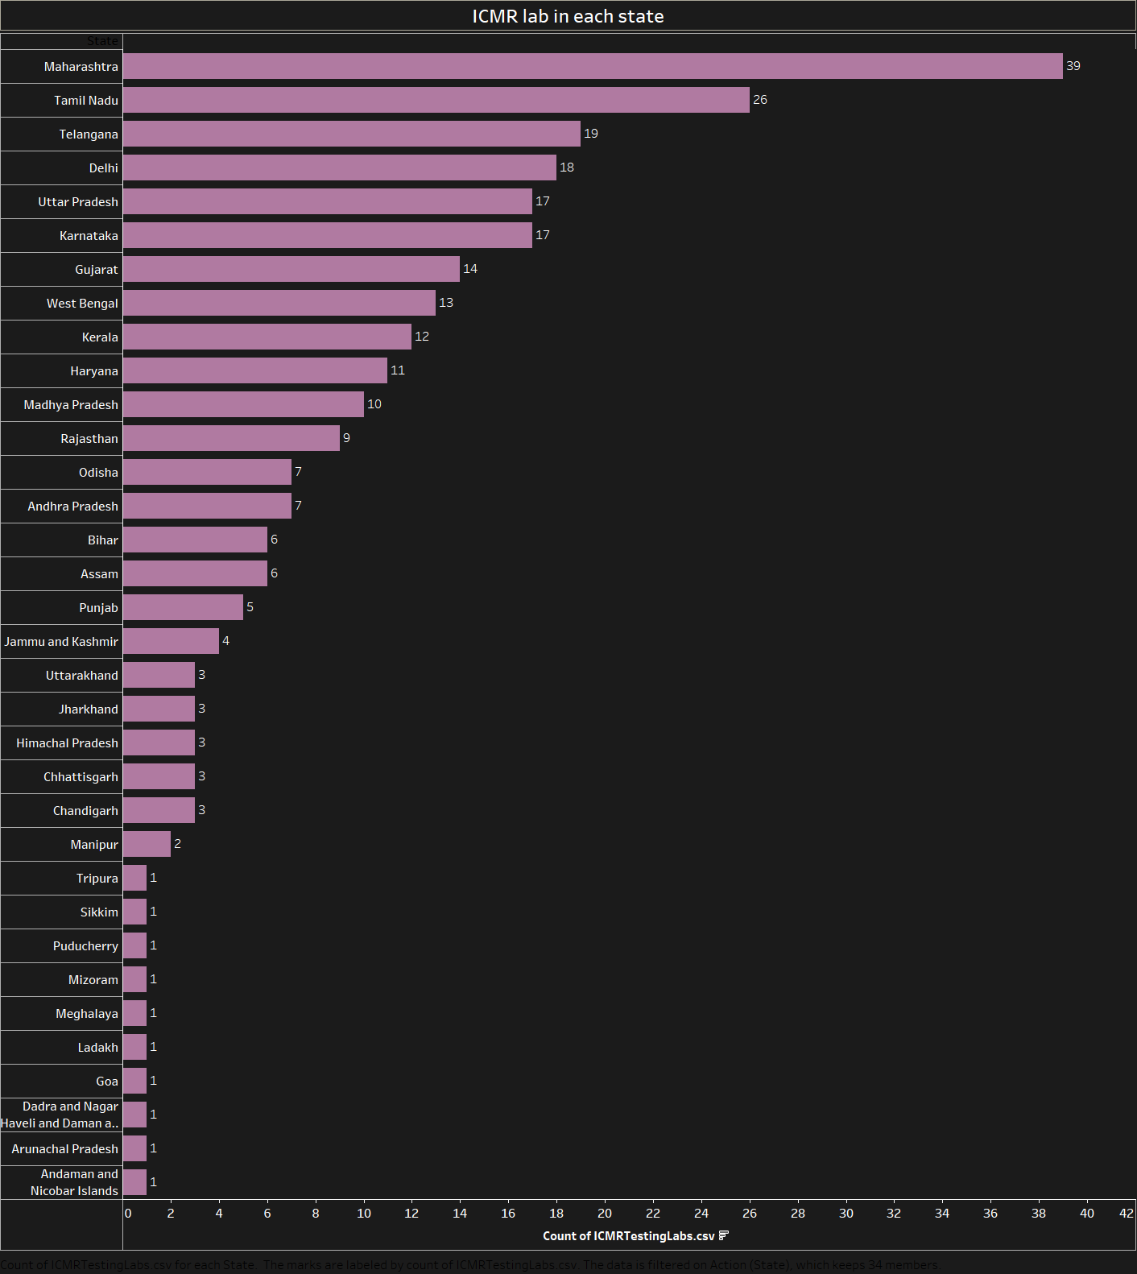

Slide 9


Slide 10
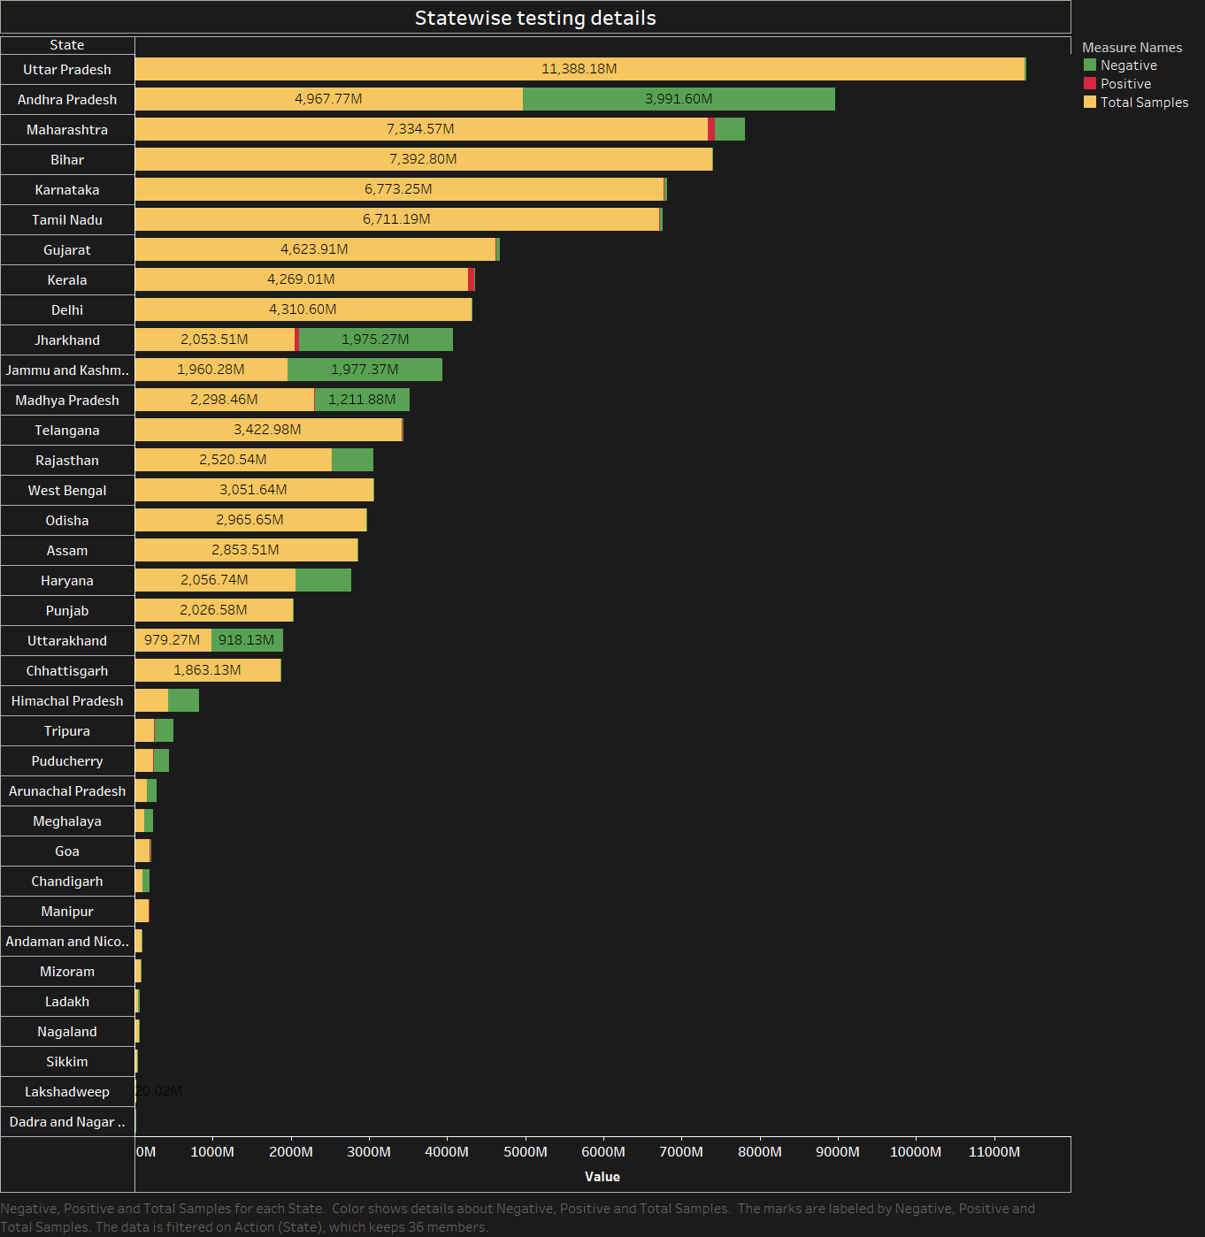

Slide 11
